Slide 1
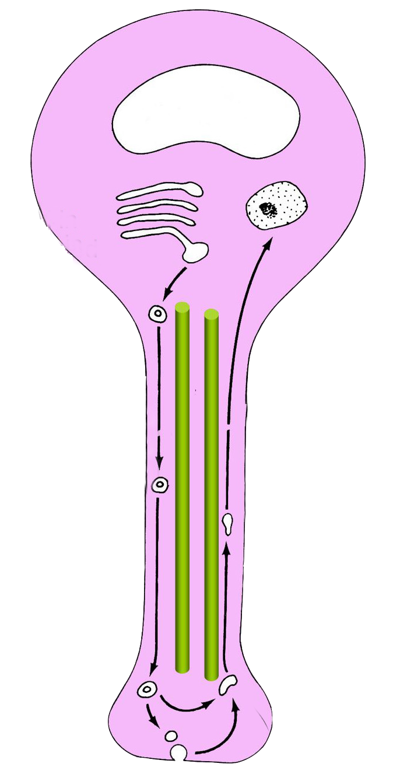
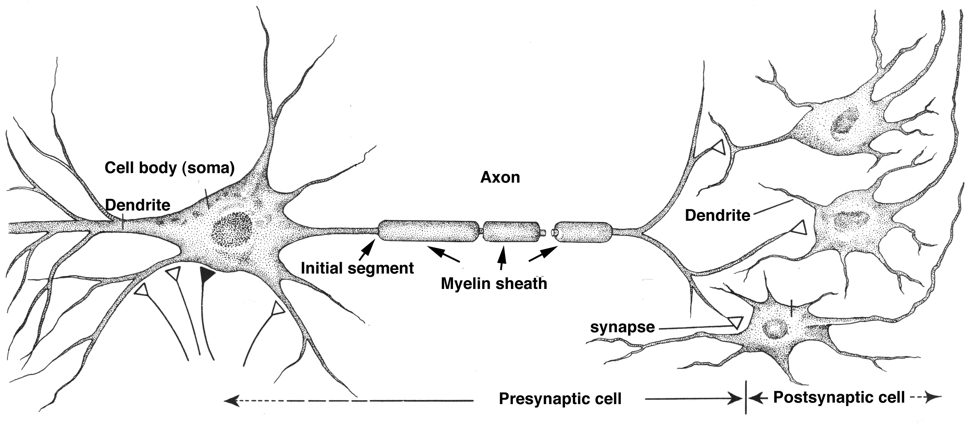
Neurological Disorders Lesson 2.4
How do our neurons transport the materials they need?
nucleus
1.
nucleus
2.
5.
3.
4.
synapse
synapse

Slide 2
Do Now:
Complete Part 1 on your worksheets.
Sort the components into the appropriate neuronal compartments.
Dendrites
Axon
Cell Body

Slide 3
What would you find in...
Dendrites | Cell Body | Axon

Slide 4
What would you find in...
Dendrites | Cell Body | Axon
Receptor proteins
Ion channels
Growth factors

Slide 5
What would you find in...
Dendrites | Cell Body | Axon
Receptor proteins | Nucleus
Ion channels | Mitochondria
Growth factors | Golgi apparatus
 | Endoplasmic reticulum
 | Synaptic vesicles

Slide 6
What would you find in...
Dendrites | Cell Body | Axon
Receptor proteins | Nucleus | Ion channels
Ion channels | Mitochondria | Mitochondria
Growth factors | Golgi apparatus | Neurotransmitters
 | Endoplasmic reticulum | Synaptic vesicles
 | Synaptic vesicles

Slide 7
What would you find in...
Dendrites | Cell Body | Axon
Receptor proteins | Nucleus | Ion channels
Ion channels | Mitochondria | Mitochondria
Growth factors | Golgi apparatus | Neurotransmitters
 | Endoplasmic reticulum | Synaptic vesicles
 | Synaptic vesicles

Slide 8
Moving components to and from the synapse
nucleus
nucleus
1.
2.
5.
3.
4.
synapse
synapse

Slide 9
Moving components to and from the synapse
Complete Part 2 on your worksheet.
Match the process with the number in the picture.
Vesicles are filled with neurotransmitter and then the action potential makes the vesicles release their neurotransmitter into the synapse
The cell body makes hollow spheres of membrane called vesicles
Vesicles that need repairing are transported back to the cell body
Vesicles can be refilled with transmitter or repaired if they are damaged
Vesicles are transported to the synapse on microtubule tracks.
nucleus
3.
1.
1.
2.
5.
5.
4.
3.
4.
synapse
2.

Slide 10
How do we do it – and how do we do it fast enough?
nucleus
1.
Vesicles are transported to the synapse on microtubules tracks.
Microtubules have “plus-ends” and “minus-ends”.
Plus-ends are oriented toward the synapse.
Minus-ends are oriented toward the cell body.
Minus-end
Microtubule
2.
5.
3.
Plus-end
4.
synapse
Notes:
http://www.ovguide.com/vesicle-transport-along-microtubule-9202a8c04000641f80000000052406d7

Slide 11
Vesicular Transport
Notes:
If you are having difficulties playing this video through the PowerPoint slide, you can access it online at: http://sites.tufts.edu/greatdiseases/modules/neurological-disease/multimedia-backup/

Slide 12
What did you notice about vesicle transport?
nucleus
1.
Transport can be in two directions.
The same vesicle can move backwards and forwards
Vesicles don’t move all the time.
When they are moving, they move at the same speed.
2.
5.
3.
4.
synapse

Slide 13
How might transport work?
nucleus
1.
The vesicles must be motorized to allow them to move up and down.
2.
5.
3.
4.
synapse

Slide 14
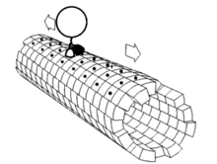
Motor Proteins A day in the life of a Motor Protein
Kinesin
Moves toward plus-end of microtubules
Toward the synapse
Dynein
Moves toward minus-end of microtubules
Toward the cell body
Vesicle
Vesicle
Kinesin
Dynein
Microtubule
Plus-end
Microtubule
Minus-end

Slide 15
Axonal Transport
Complete Part 3 on your worksheet.
For each component, determine:
Where it needs to go
What direction it will travel on the microtubule tracks
Which motor protein it will use

Slide 16
Wrap Up:
Component | Where does it need to go? | Direction on microtubules | Motor Protein
Nerve growth factor
New synaptic vesicle
Old synaptic vesicle
Herpes simplex virus
Mitochondria

Slide 17
Wrap Up:
Component | Where does it need to go? | Direction on microtubules | Motor Protein
Nerve growth factor | From the synapse to the cell body | Toward the minus-end | Dynein
New synaptic vesicle
Old synaptic vesicle
Herpes simplex virus
Mitochondria

Slide 18
Wrap Up:
Component | Where does it need to go? | Direction on microtubules | Motor Protein
Nerve growth factor | From the synapse to the cell body | Toward the minus-end | Dynein
New synaptic vesicle | From the cell body to the synapse | Toward the plus-end | Kinesin
Old synaptic vesicle
Herpes simplex virus
Mitochondria

Slide 19
Wrap Up:
Component | Where does it need to go? | Direction on microtubules | Motor Protein
Nerve growth factor | From the synapse to the cell body | Toward the minus-end | Dynein
New synaptic vesicle | From the cell body to the synapse | Toward the plus-end | Kinesin
Old synaptic vesicle | From the synapse to the cell body | Toward the minus-end | Dynein
Herpes simplex virus
Mitochondria

Slide 20
Wrap Up:
Component | Where does it need to go? | Direction on microtubules | Motor Protein
Nerve growth factor | From the synapse to the cell body | Toward the minus-end | Dynein
New synaptic vesicle | From the cell body to the synapse | Toward the plus-end | Kinesin
Old synaptic vesicle | From the synapse to the cell body | Toward the minus-end | Dynein
Herpes simplex virus | From the synapse to the cell body | Toward the minus-end | Dynein
Mitochondria

Slide 21
Wrap Up:
Component | Where does it need to go? | Direction on microtubules | Motor Protein
Nerve growth factor | From the synapse to the cell body | Toward the minus-end | Dynein
New synaptic vesicle | From the cell body to the synapse | Toward the plus-end | Kinesin
Old synaptic vesicle | From the synapse to the cell body | Toward the minus-end | Dynein
Herpes simplex virus | From the synapse to the cell body | Toward the minus-end | Dynein
Mitochondria | From cell body to synapse | Toward the plus-end | Kinesin

Slide 22
Homework
Complete Part 4 on the worksheet, addressing the question:
How much energy does neuronal transport use?

